Slide 1


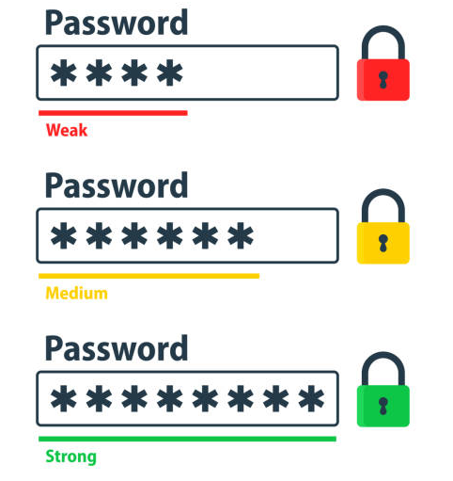
Session 2
Cyber Security - Password Strength & Complexity

Slide 2
Learning Outcomes
What is password complexity?
The benefits of password complexity
What are the rules for password complexity?
Analyzing what makes a password strong and common vulnerabilities in password security.

Slide 3
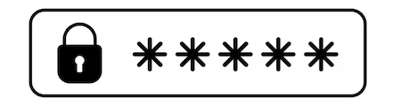
What is password complexity?
Password complexity is a measure of how difficult a password is to guess in relation to any number of guessing or cracking methods.
In some cases, the term is also used to refer to requirements for password selection that are designed to increase password complexity in the interest of better security.
Password complexity is important because guessed passwords are a common avenue for attack, and thus, for data breaches. When passwords can be guessed, individuals other than the owner of an account or resource are able to access that account or resource without permission.
Complex Password Example: m#P52s@ap$V
This is a great example of a strong password. It's strong, long, and difficult for someone else to guess. It uses more than 10 characters with letters (both uppercase and lowercase), numbers, and symbols, and includes no obvious personal information or common words.

Slide 4
The benefits of password complexity
The main benefit of password complexity rules is that they enforce the use of unique passwords that are harder to crack.
The more requirements you enforce, the higher the number of possible combinations of letters, numbers, and characters. This increases the amount of work a computer will have to do to crack the password, thereby increasing the time it takes to crack a password.
If it takes too long to crack, some attackers will abandon it and attempt to go after easier targets. This is the crux of password cracking.
There are, generally, two widespread misconceptions about password complexity, which are as follows:
That your device or application isn’t valuable enough for an attacker to invest their time into cracking your password.
That password complexity is all about making an impossible password that can never be guessed by an outsider.

Slide 5
What are the rules for password complexity?
There are several common rules for password complexity that are designed to encourage a user to take extra precautions in creating a stronger password. The common ingredients involved in password strength or complexity, include:
Character length :- The length of a password matters, and increasingly, the minimum password length is 8 characters. Many have argued that the longer the password, the harder it is to crack, guess or steal – therefore deterring attacks.
Use of special characters:- Special characters refer to those that are not alphabetic or numeric, but will typically still feature on most keyboards. Special characters are used to deter users from using identifiable phrases (these include !@#£%)
Use of numbers:- Making effective use of numbers will help user create complex passwords as it opens up more possible combinations.
A mix of upper and lowercase letters :-Similar to using numbers or digits in your password, upper and lowercase letters can offer users even more combinations, keeping passwords safe and more secure
Avoidance of personal information :- Personal details can be exploited, and even more easily guessed, making this a clear weakness for any employees making a new password.

Slide 6
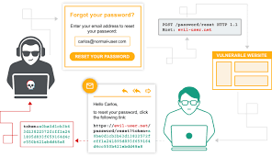
What are Password Vulnerabilities?
Password vulnerabilities mean that the person creates a password for a website account, and the password that is created is weak, such as 1234, 4321, or his date of birth. In that case, hackers easily crack the password, access our website accounts, and steal sensitive information. We secure a password by putting strong passwords with a combination of letters, numbers, or any special characters, and the length of the password varies from 8 to 16. Using multi-factor authentication also resolves the password risk.

Slide 7
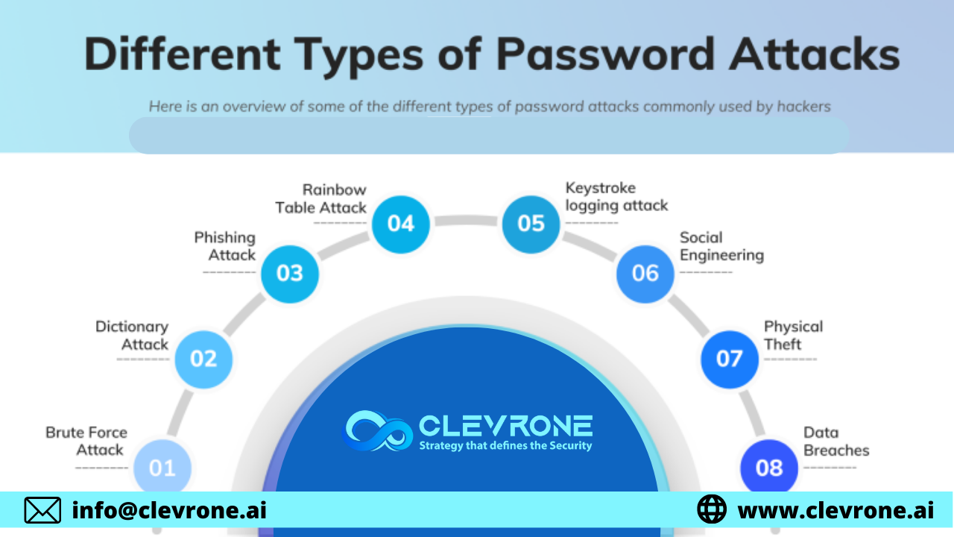
Vulnerabilities in Password-Based Login
Passwords are essential for online security, but they are vulnerable to various attacks. Here are some common threats and their prevention strategies:

Slide 8
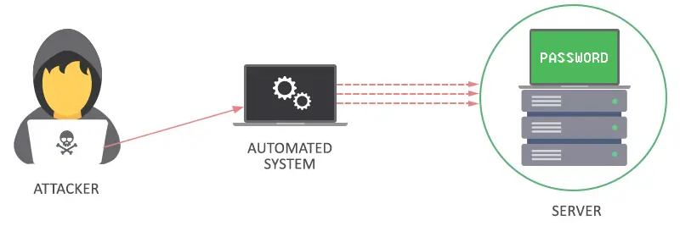
1. Brute Force Attack
Description: Hackers guess passwords using numerous combinations, including common sequences like birthdays or simple numbers.
Prevention:
Avoid using the same password across different sites.
Don’t use easily guessable information (e.g., birthdays, names).
Enable two-factor authentication (2FA) for an extra security layer.

Slide 9
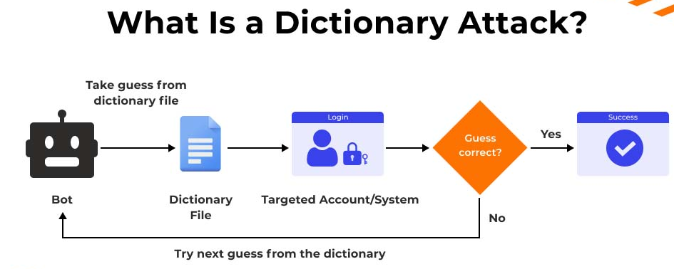
2. Dictionary Attack
Description: Hackers use common words, phrases, or previously leaked passwords to crack accounts, often targeting financial sites.
Prevention:
Create complex passwords with a mix of uppercase and lowercase letters, numbers, and special characters.
Implement account lockout policies after multiple failed login attempts.
Regularly change or reset passwords

Slide 10
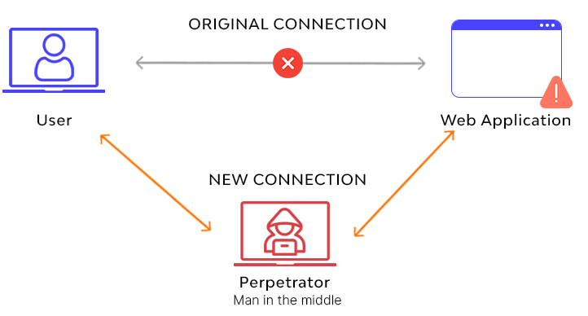
3. Man-in-the-Middle Attack
Description: Attackers intercept communications between users and websites, often through phishing emails.
Prevention:
Secure Wi-Fi networks with strong passwords.
Regularly update devices and software.
Monitor accounts for suspicious activity and use multi-factor authentication.

Slide 11
4. Spidering Attack
Description: Hackers exploit company-related information to guess passwords easily, especially in corporate environments.
Prevention:
Use strong, unrelated passwords for company accounts.
Change passwords immediately if any suspicious activity is detected.
Avoid storing passwords in easily accessible locations like spreadsheets.

Slide 12
PYTHON PRACTICAL ACTIVITY ( Code Link )
Practical Activity # 1 (Password Strength Analyzer)
Practical Activity # 2 (Brute Force Simulation)
Practical Activity # 3 (Dictionary Attack Detector)
Practical Activity # 4 (Password Generator)
Practical Activity # 5 (Password Policy Validator)

Slide 13
Practical Activity # 1 (Password Strength Analyzer)
🔍 Analyzes passwords based on common complexity rules.
import re
def analyze_password_strength(password):
print("\n🔐 Password Strength Report:")
score = 0
if len(password) >= 8:
score += 1
if re.search(r"[A-Z]", password):
score += 1
if re.search(r"[a-z]", password):
score += 1
if re.search(r"[0-9]", password):
score += 1
if re.search(r"[!@#$%^&*()_+]", password):
score += 1
if score == 5:
print("✅ Excellent – Very Strong Password")
elif score >= 3:
print("⚠️ Moderate – Consider improving it")
else:
print("❌ Weak – Easy to crack")
password = input("Enter a password to check its strength: ")
analyze_password_strength(password)

Slide 14
Practical Activity # 2 (Brute Force Simulation)
🧠 Simulates how long it might take a brute force attack to guess your password based on length and character set.
import math
def time_to_crack(length, charset_size):
attempts = charset_size ** length
guesses_per_sec = 1000000000 # 1 billion guesses/second (modern GPUs)
seconds = attempts / guesses_per_sec
years = seconds / (60 * 60 * 24 * 365)
return years
print("🔐 Brute Force Attack Simulation")
length = int(input("Enter the length of your password: "))
charset_size = int(input("Enter estimated charset size (26=letters, 52=upper+lower, 62+specials=95): "))
years = time_to_crack(length, charset_size)
print(f"⏳ Estimated time to crack: {years:.2f} years")

Slide 15
Practical Activity # 3 (Dictionary Attack Detector)
📖 Checks if your password matches common dictionary words.
common_words = ["password", "123456", "qwerty", "letmein", "admin", "welcome"]
def is_dictionary_based(password):
return password.lower() in common_words
password = input("Enter a password: ")
if is_dictionary_based(password):
print("❌ Weak! Your password is in the common dictionary.")
else:
print("✅ Good! It's not a known dictionary word.")

Slide 16
Practical Activity # 4 (Password Generator)
🔧 Builds strong passwords with customizable settings.
import random
import string
def generate_password(length=12):
chars = string.ascii_letters + string.digits + "!@#$%^&*()"
password = ''.join(random.choice(chars) for _ in range(length))
return password
length = int(input("How long should the password be? (min 8): "))
if length < 8:
print("❌ Password too short!")
else:
print("🎯 Suggested Strong Password:", generate_password(length))

Slide 17
Practical Activity # 5 (Password Policy Validator)
🧾 Checks passwords against typical enterprise password policies.
def validate_password(password):
issues = []
if len(password) < 10:
issues.append("Password too short (minimum 10 characters).")
if not re.search(r"[A-Z]", password):
issues.append("Include at least one uppercase letter.")
if not re.search(r"[a-z]", password):
issues.append("Include at least one lowercase letter.")
if not re.search(r"\d", password):
issues.append("Include at least one digit.")
if not re.search(r"[!@#$%^&*()_+=]", password):
issues.append("Include at least one special character.")
if issues:
print("⚠️ Your password has the following issues:")
for issue in issues:
print(f"- {issue}")
else:
print("✅ Your password meets standard policy requirements!")
password = input("Enter a password to validate: ")
validate_password(password)

Slide 18


Exercise
1. What is the primary goal of enforcing password complexity rules? A) To make passwords longer and harder to remember B) To increase the number of characters for visual appeal C) To reduce the chance of a password being cracked D) To enable single sign-on for users Answer: C
2. Which of the following is a common vulnerability associated with weak passwords? A) Token mismanagement B) CAPTCHA failure C) Dictionary attack D) Biometric spoofing Answer: C

Slide 19
Exercise
3. Why should personal information be avoided in passwords? A) It increases the length of the password B) It can be used in multi-factor authentication C) It is easily guessable by attackers D) It violates password storage regulations Answer: C
4. Which special character set increases password complexity? A) Only alphabets B) Uppercase letters only C) Numbers and vowels D) Characters like !, @, #, $, % Answer: D
5. What does a brute-force attack rely on to break passwords? A) Exploiting expired tokens B) Trying all possible character combinations C) Reading login logs D) Using advanced biometric tools Answer: B

Slide 20
Quiz
Now it’s your chance to apply what you’ve learned! Click the link below to take an interactive quiz in the Streamlit app. This quiz will test your knowledge of Cyber Fundamentals and their role in Information Security.
How to Approach the Quiz:
Understand Cyber Security Basics: Make sure you know the core concepts of Cyber Fundamentals, including protecting systems, networks, and data from cyber threats like hacking, malware, and phishing.
Choose Your Answers Carefully: Think about how basic cybersecurity principles apply in real-world situations and how they protect information from attacks.
Test Your Knowledge: The quiz will help you evaluate how well you understand the fundamentals of cybersecurity and how to stay safe online.
Click here to begin the quiz: https://www.passwordmonster.com/

